Slide 1
Welcome to Year 1
^{SEPTEMBER 2024}

Slide 2
Hello
We are Year One!
Super Satin Mice

Slide 3
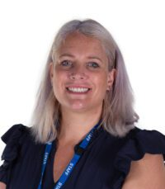
Teacher in Year 1
Mrs Wilmott

Slide 4
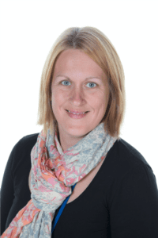
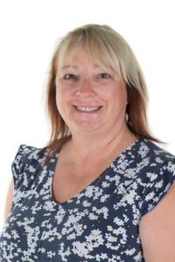
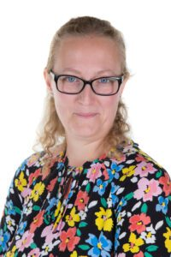
Staff in Year 1
Miss Wakefield will teach on a Wednesday afternoon.
Mrs Purdy Monday-Thursday
Mrs Hallam-Friday and nurture/phonics/writing interventions.

Slide 5
Morning and End of Day
School starts at 8.55am and finishes at 3.25am
Mrs Wilmott is usually available at these times, after school we can be more flexible if you need to see us.
If someone different is collecting, please call the office, pop a message on Dojo or see me at the start of the day ☺
Daily posts will be added to Dojo at the end of each day.

Slide 6

Reading
If you read 5 times a week the children get a stamp on their church tower chart and their photo goes on the reading tower in the corridor.
When it is full we celebrate in our Awards Assembly and the children get a new book.
Reading books need to be in school every day.

Slide 7
Reading and Phonics
We have started a new phonics and reading scheme this year called Little Wandle.
These books will also be used for group reading in class three times a week so these will only be changed once each week.
Our Library day is a Tuesday when the children can change their reading for pleasure book.

Slide 8
Reading
Children will have a library book and a Little Wandle reading book linked to the phonic sounds we are learning in class.

Slide 9
Phonics
We use the Little Wandle Phonics scheme throughout school
It is one of the most popular government approved schemes with a very good outcomes for pupils.
Their website has a parent’s section but as we introduce each part we will share information with you.
https://www.littlewandlelettersandsounds.org.uk/resources/for-parents/#tabnametabHowWeTeach

Slide 10
Our Curriculum
On the website there is a link to what we learn in Year 1.
https://www.langleymillinfantschool.co.uk/curriculum/classes/
Every term I add a medium-term plan which has news and updates that shows what we will be learning and any events for the term.
Extra events and any other news will be added to Dojo as we need to.

Slide 11
Our topics..
Topics this year
Autumn 1 – Cool School ( Victorian day will be Monday 14th October)
Autumn 2 – The Great Fire of London
Spring – Hullaballoo Zoo
Spring – Outstanding Oceans
Summer – Castles and Crowns
Summer – Fairytales
More details for each of these topics will be on the medium- term plans and class newsletters.

Slide 12
PE days – Monday and Friday, please have pumps
  in school all the time and come in your active uniform.
Snack – fresh fruit is provided everyday at play time, this comes from the Government healthy schools initiative.
Water bottles are kept in the classroom and the children can refill them whenever they need to.
Wellies on pegs are also really useful during the year so we can still get outside all year round.
Please make sure you have signed up to Dojo, come and speak to us if you’re having any problems with this.

Slide 13
Behaviour and Awards
We have a positive approach to behaviour regulation.
Bucket fillers are rewarded each day using Dojo points and one child receives the class award each week.
The Super Satin Mice of the week is awarded every Friday in our celebration assembly, this award is linked to our school values.

Slide 14

School vision and values

Slide 15
How can you help ☺…
Read, read, read!
Please read 5 times a week whenever you can, it really does make a difference.

Slide 16
Other information ☺…
After school clubs will run throughout the year both with school staff and the outside providers that we use.
Miss Crossley the Family Support Worker is available if you have concerns that you wish to discuss.
Miss Brown our school SENDCo is also available if you have a concern that you would like to discuss.

Slide 17
Thank you for coming!
We are available if you have any worries at the beginning or end of the day!
Or send us a message on Dojo.
Any questions, please ask ☺

